Slide 1
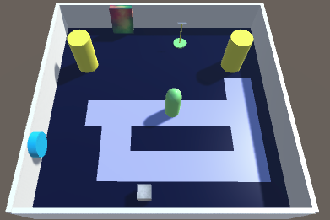
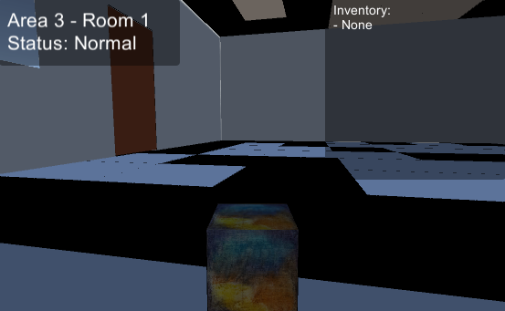
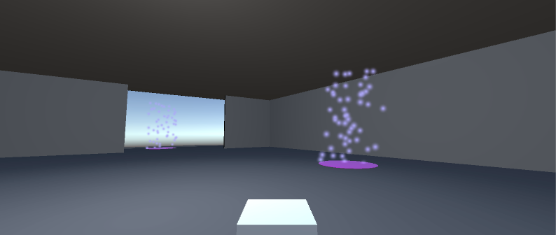
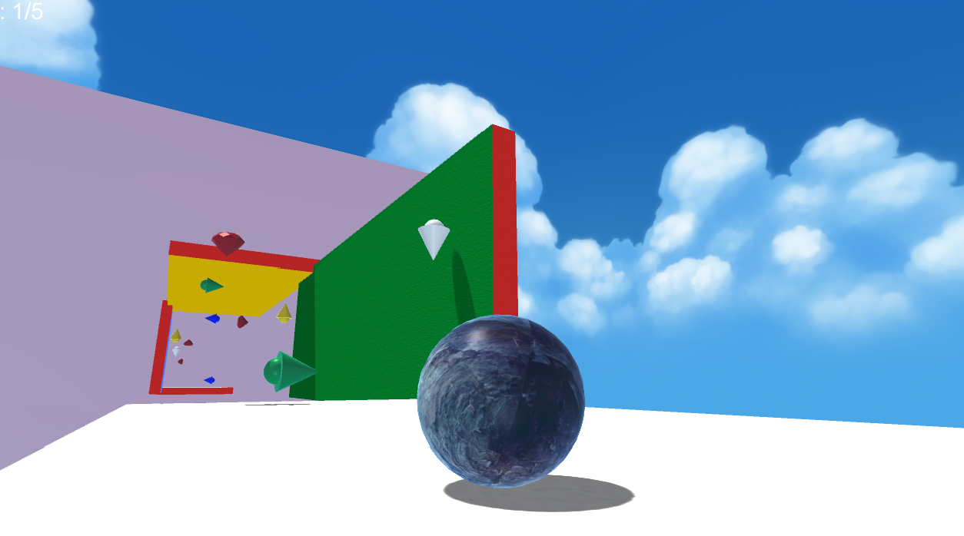
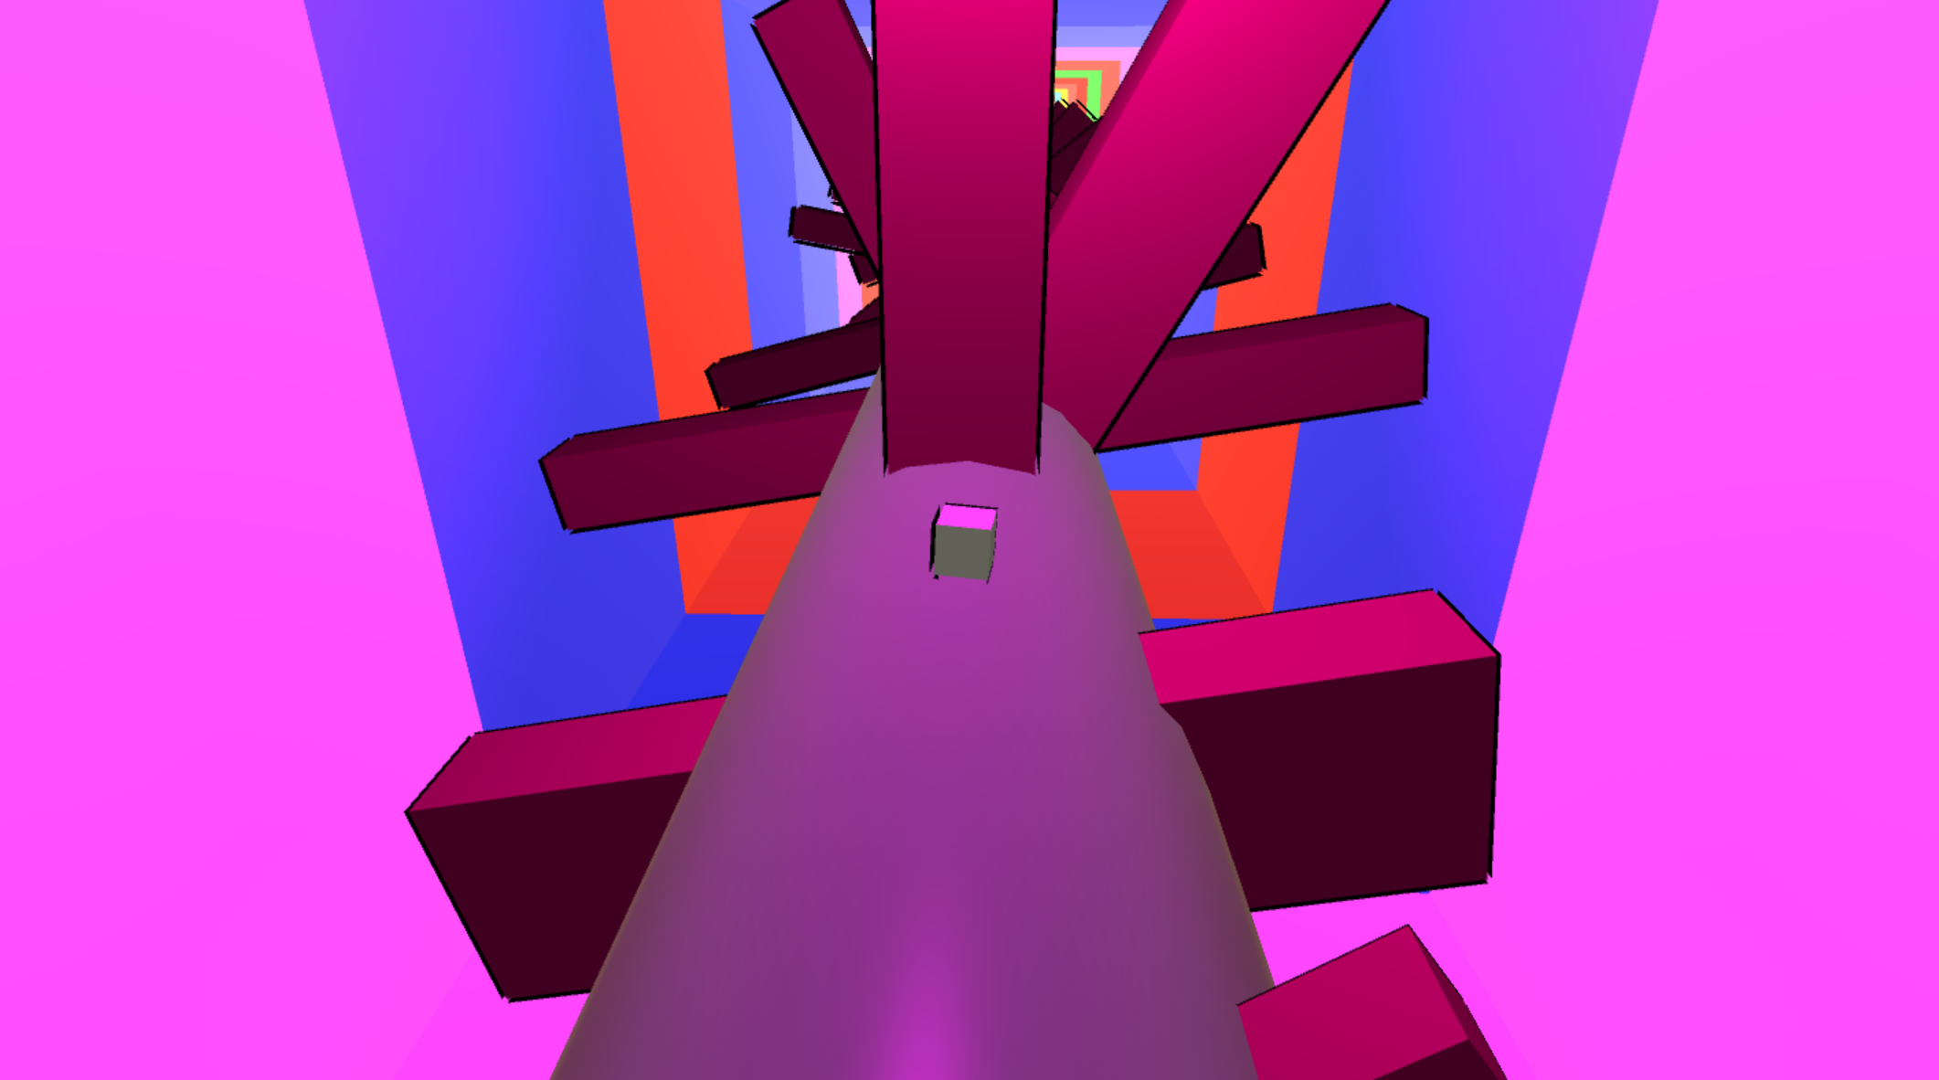
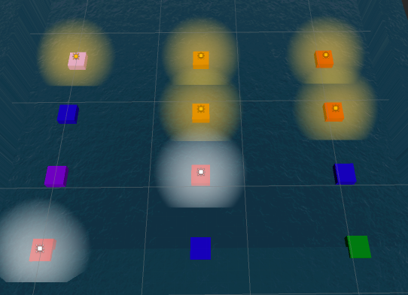
Legend of Cubie
Team Geotronics
Taumer Anabtawi | Jessica Kasson | Paul Kim | James Lowrey | Bob Tishma
The Legend of Sphera is a platform and puzzle based game where our humble hero Cubie must overcome challenges and complete The Four Trials to win the heart of the beloved Princess Sphera. Legend has it that only a shape pure of heart and character is able to complete the trials. Many have tried, all have failed. The Kingdom of Shapeland is governed by a class system where a shape's place in society is dictated by the number of sides the shape has; cubes at the bottom and perfect spheres regarded as divinity. Despite the princess’s objection to this class system, she alone cannot sway the shapes. Our Hero Cubie however, aims to prove these shapes wrong. Cubie challenges this system and the ideology behind it and embarks on a journey to complete the Four Trials and drink from the Holy Waters needed to win Sphera's heart.
Controls
Stroy
Movement Camera
Jump/Action
Game Play
Key
Home Base
Gas
Stage 1
Game Play
Hit the goal object using a ball shot by lever and guided using various elements in the stage.
This stage consists of 3 levels. Each level has a puzzle to be solved. The puzzles increase in difficulty, and when you complete all stages, you will get the key for the transformation machine.
Stage 4
Game Play
Three levels of two to four varied smaller puzzles, ranging across platforming, mazes, sudoku, observation, music, and other sense. Upon completing each puzzle and level, you move onto the next one. At the end of several different tests of adaptation, Cubie receives the gas tank to the transformation machine.
Transform
Machine
Made?
Gear
Stage 5
Game Play
Using your new found powers, control gravity to attain the Sacred Waters needed to win the princess’s love. This stage is platforming level with pickups, powerups, and hazards. Cubie must manipulate gravity to collect the sacred gems and achieve his destiny.
Framework
Stage 2
Game Play
Spin along and dodge obstacles as you test your reflexes and race against time. Stay sharp! The longer you race the harder it gets. Keep dodging and at the end Cubie receives another piece for his transformation machine.
Stage 3
Game Play
A series of logic puzzles that test your intelligence and wit. First, try to crack the color code by toggling colors based on hints received after every try. Every wrong answer brings upon you a deadly firestorm. If you survive, take a chance in the perplexing desert maze where Sphere Wizards try to stop you in your tracks. Can you figure out how to survive?
End

